Slide 1
NIH Recycling
Basics, Beyond the Bin, & Bookmarks

Slide 2
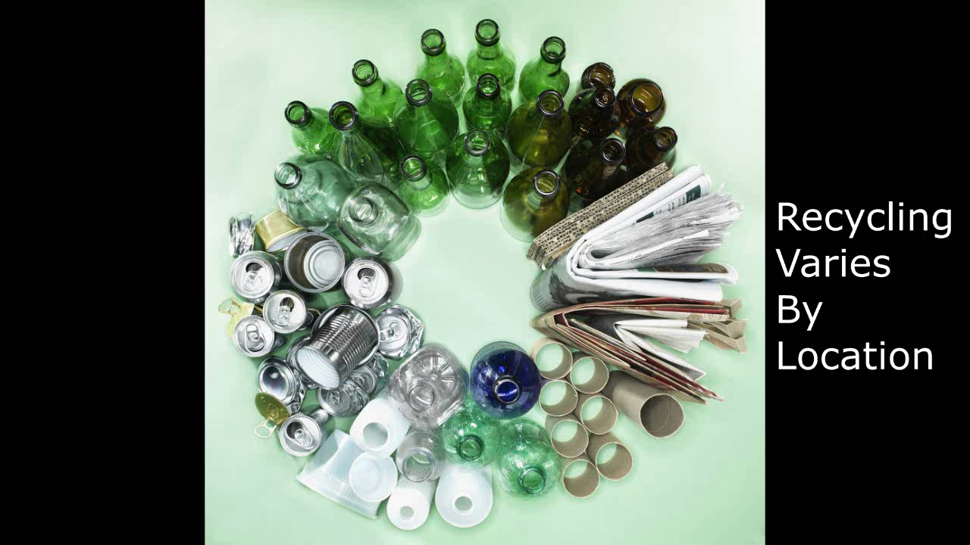
The Basics
(Press Play Below for 2 Minute Video)
Bethesda
Solid Waste Recycling--
Assistance: 301.496.7990
On-Campus Pick-up: 301.402.6349
Chemical Waste Recycling (e.g. Batteries, Light Bulbs)
Assistance: 301.496.7990
Pick-up: 301.496.4710
Government Property Recycling--
301.496.4247
Montgomery Co. Leased Facilities
Montgomery Co. Leased Facility Manager Directory: https://orfapps.od.nih.gov/FacilityManagement.asp
Baltimore
443.470.2761
Frederick
IRF—301.631.7238
NCI—301.486.1102
Research Triangle Park
919.541.4234
Rocky Mountain Laboratories
406.363.9216
Let’s review some basic recycling and sorting.
Notes:
Recycling and Solid Waste Management vary by location. For specific guidance and assistance, reach out to waste managers at your facility.
A review of some basic recycling and sorting of Paper & Plastic/Metal/Glass—
Recycle clean and dry paper, such as: newspaper, magazines, scientific journals, catalogs, post-it notes, manila folders, envelopes, tissue and paper towel boxes (not the actual tissues and paper towels themselves), white or colored paper, frozen food boxes (not actual food), and paper board.
Flatten cardboard boxes
Plastic, metal, and unbroken glass containers, cans, and bottles. All containers should be empty. Lab containers and bottles should not be recycled in the same bin as consumer containers.
You can also recycle, where appropriate, toner & inkjet cartridges, pipette tip racks, and batteries (chemical waste).
If you have a delivery on a wooden pallet, ask the delivery person to take the pallet back to the loading dock.
To send government property and electronics on the path of reuse or recycle (Surplus), contact your Property Custodial Officer (PCO). If you are unsure of who your PCO is, your IC Property Accountability Officer can assist. Both accountable and non-accountable items (decal or no decal) can be Surplused.

Slide 3
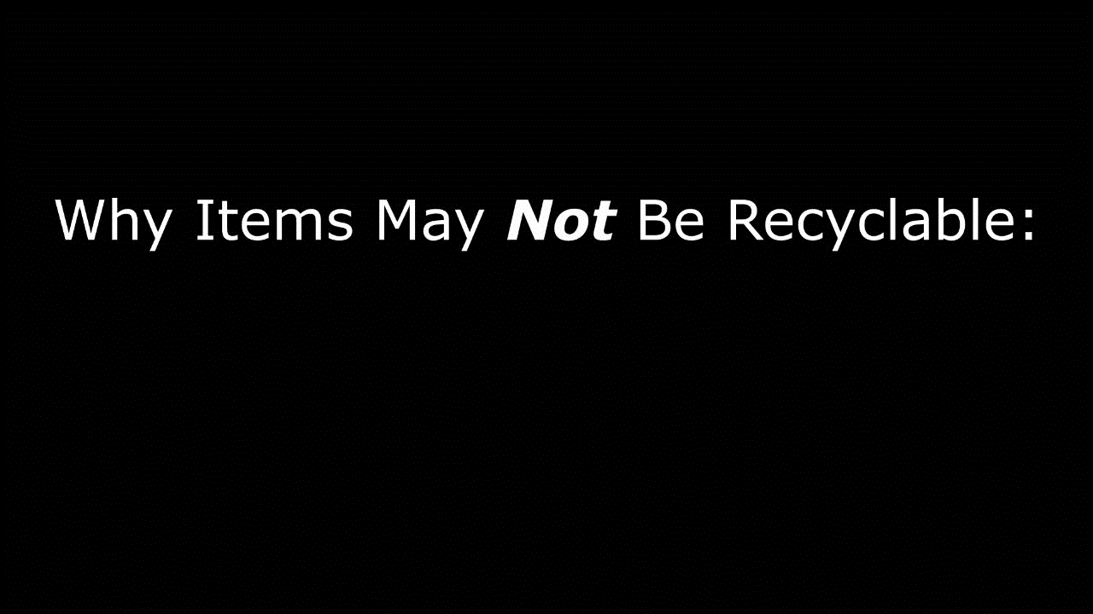
Beyond the Bin
(Press Play Below for 2 Minute Video)
Bethesda
Solid Waste Recycling--
Assistance: 301.496.7990
On-Campus Pick-up: 301.402.6349
Chemical Waste Recycling (e.g. Batteries, Light Bulbs)
Assistance: 301.496.7990
Pick-up: 301.496.4710
Government Property Recycling--
301.496.4247
Montgomery Co. Leased Facilities
Montgomery Co. Leased Facility Manager Directory: https://orfapps.od.nih.gov/FacilityManagement.asp
Baltimore
443.470.2761
Frederick
IRF—301.631.7238
NCI—301.486.1102
Research Triangle Park
919.541.4234
Rocky Mountain Laboratories
406.363.9216
Be considerate of those who manage recycling beyond the bin. Follow proper waste disposal procedures.
Notes:
There are things that do not belong in the general recycle bin because they are too difficult to sort out at material recovery facilities (MRFs), are a hazard, and/or make the acceptable recyclables in the bin unclean.
Food can be composted, when composting organics is an available option. However, putting food and free liquids in a general recycle bin for paper or plastic/metal/glass may cause that whole bag of recyclables to be routed to trash instead because unclean material is not marketable for recycling. Recyclability is marketability.
Collection of bags and plastic film is kept separate from general recycling of containers, bottles, and cans. Having to pick out plastic bags from other materials at a material recovery facility (MRF) is a very laborious and costly process. Often bags and film get stuck in machinery, delaying operations.
However, plastic film materials like plastic bags can be recycled at drop-off locations such as retail stores.
Utensils are also not always easy to recovery at sort facilities.
Chip bags and candy wrappers may have a plastic and metal component, which makes recycling difficult. There are few outlets for these.
Hazardous chemicals, radioactive materials, infectious substances, and medical waste have no place in a recycle bin. This poses a risk to people who manage recycling beyond the bin. Follow proper waste disposal procedures for these wastes.

Slide 4
Bookmarks and Helpful Resources:
NIH Waste Disposal Guide
http://nems.nih.gov/programs/WM/Documents/Waste_Disposal_Guide.pdf
NIH Environmental Management System (NEMS) Recycling Webpage
http://nems.nih.gov/programs/WM/Pages/Recycling.aspx
NIH FreeStuff
https://stuff.nih.gov/Home.aspx
NIH Chemical Waste
http://nems.nih.gov/programs/WM/Pages/Chemical%20Waste.aspx
NIH Property Reutilization & Disposal (Surplus)
https://olao.od.nih.gov/division-logistics-services/property-management-branch/property-reutilization-disposal-section
PSC Shredding Services
http://www.psc.gov/building-operations/shredding.html
Plastic Terminology (Various Resin Forms and Uses)
https://www.recycleyourplastics.org/recycling-professionals/education/terms-tools/#
Plastic Film Recycling
http://www.plasticfilmrecycling.org/
Biodegradable Product Catalog
http://products.bpiworld.org/

Slide 5
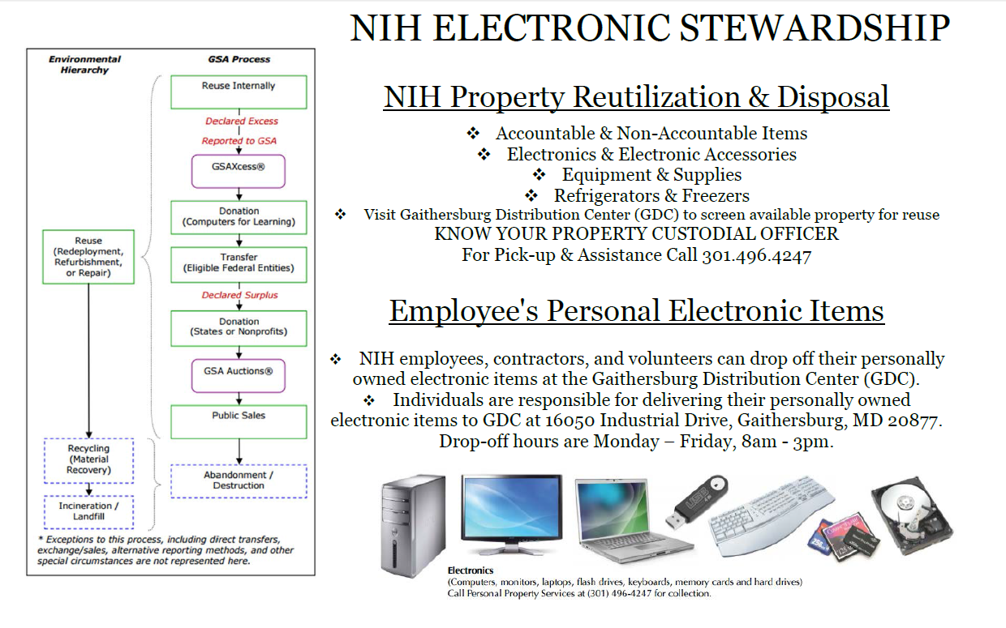
*NIH E-Waste*
Notes:
To send government property and electronics on the path of reuse or recycle (Surplus), contact your Property Custodial Officer (PCO). If are unsure of who your PCO is, your IC Property Accountability Officer can assist. Both accountable and non-accountable items (decal or no decal) can be Surplused.

